Slide 1
Web Security for Competitions

Slide 2

AGENDA
What is a Web server?
Practice
Demo
Hardening

Slide 3
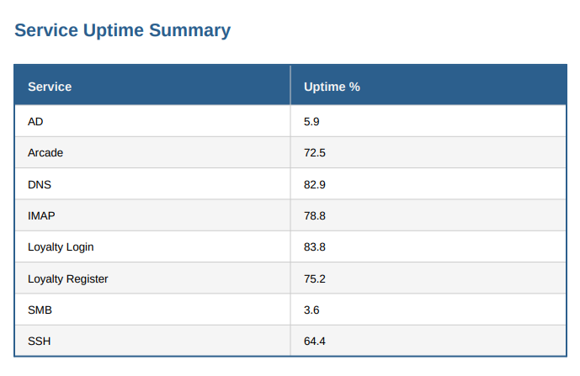
Why are we talking about this?
Collegiate Cyber Defense Competition

Slide 4
LAMP Stack
L A M P
Linux (Operating System)
Apache (Web server Software)
MySQL / Mariadb (Database)
PHP (Website scripting)
Notes:
LAMP Stack
Linux: scalable, most servers are linux servers. it’s open source (ie no paying windows licencsing costs, and it’s flexible, lightweight)
Apache: exact same reason
MySql: Exact same reason
Built around lamp stack - it was javascript before javascript.

Slide 5
Linux
Generally won’t find a windows machine running a webserver
Means we have to do Linux hardening as well as web hardening
SSH Keys
Insecure Logins
Backdoors
Outdated applications

Slide 6
Apache2
It “serves” our web pages from /var/www/html
Config is in /etc/apache2/apache.conf
OR etc/apache2/apache2.conf
We’re looking for misconfigurations and outdated versions

Slide 7
MySQL
Database schema accessible with:
mysql -u root -p
High value information / customer data. Normally one of the targets of a web server hack
We’re looking for misconfigurations and outdated versions

Slide 8
PHP
P H P
PHP
Fucking
Hypertext
Processor
Sucks

Slide 9
PHP
Javascript but server-side, not client-side
SQL injections
XSS (Cross site scripting)
Insecure Error handling
Broken Access Control (!!)

Slide 10
Recap
Linux: Harden the Operating System
Apache: If something breaks, check for misconfigurations in /etc/apache2 (or /var/log/error.log)
MySql: Keep these safe, check access to database. $mysql -u root -p
PHP: Actual Web page info. Stored in /var/www/html/<page_name>.php

Slide 11
Scenario
https://cdru-pve-eduy9lq.cdru.net/
15 minute timer
Your goal: Harden the web server as much as possible before I attack it
Remember:
Apache2: /etc/apache2, /var/log/error.log
(or access.log)
PHP: /var/www/html
User: comp00:password123

Slide 12

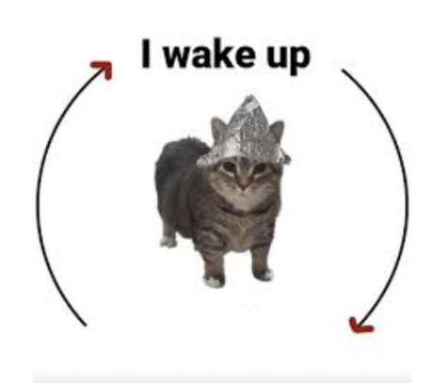
Questions?
enjoy my weekend

